Slide 1
Spectroscopy

Slide 2
Announcements
First lab is graded
Check comments directly on the submission to see where/why points were marked off
General comments are for if pages are missing/out of order or if there are technical issues
Please remember to put pages in order and a single file
I gave warnings this time since it was the first lab
I can show you a couple ways to make sure you have the right formatting if you come to office hours
Remember Pre-Lab (Should be done already) and Quiz
Sign in Sheet

Slide 3
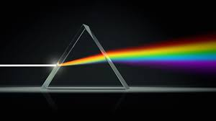
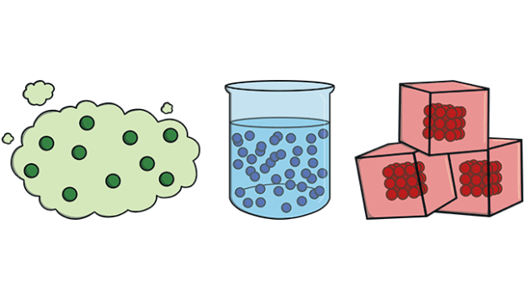
Spectroscopy
Spectroscopy is the study of the interactions between light and matter

Slide 4
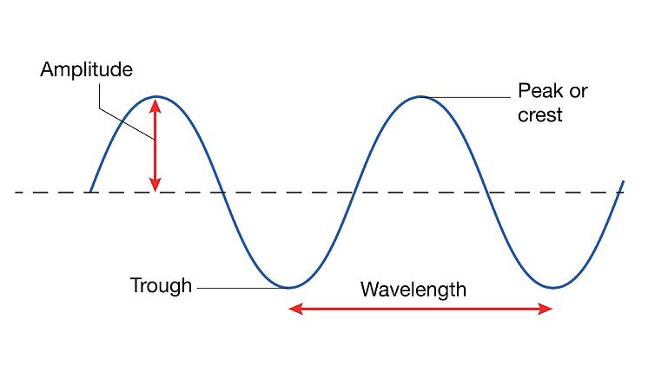
Light
A wave (kind of)
Wavelength (λ), with units of distance, is the most important for this lab
Also, frequency (f), with units of Hertz (a.k.a. per second)
c (the speed of light) = λ*f (distance per time)
Amplitude is how “tall” the wave is

Slide 5
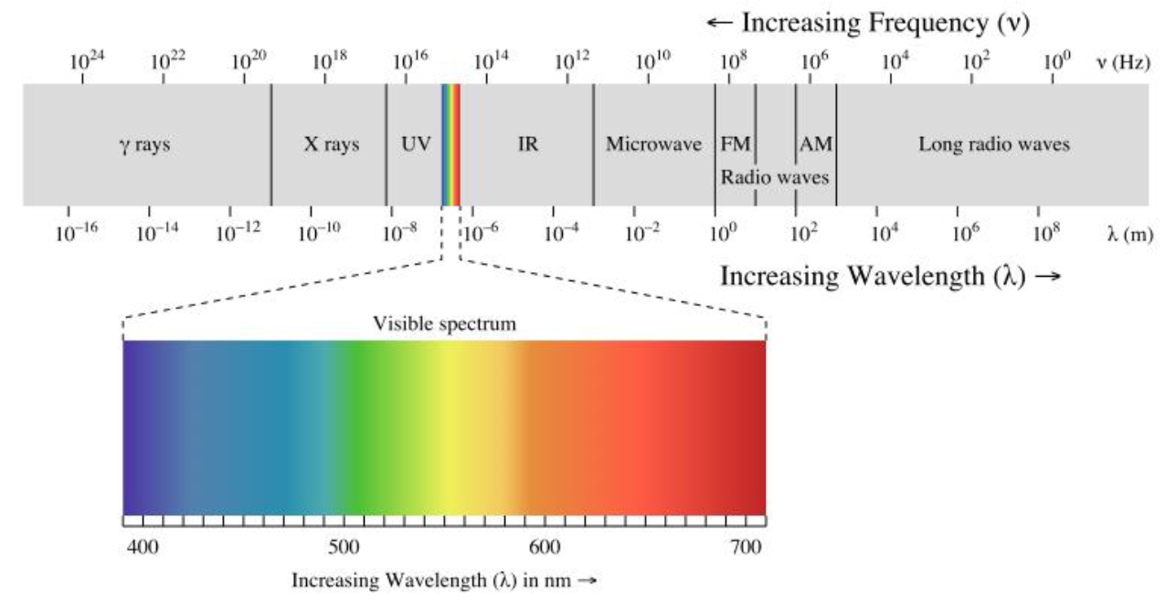
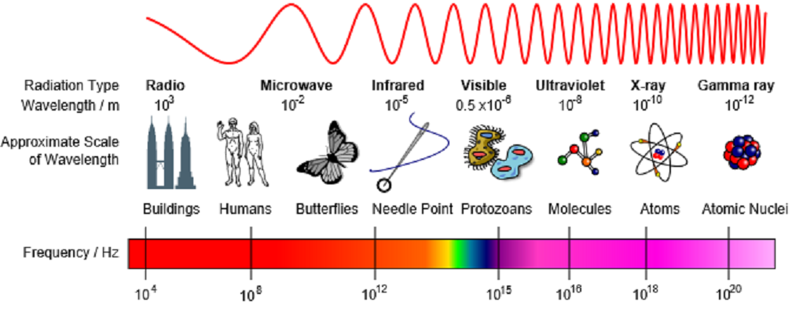
A Spectrum
Different wavelengths correspond to different “colors”
Energy:
E = hc/λ
h = Planck’s Constant = 6.626 x 10^-34 m^2 kg/s
c = speed of light = 3 x 10^8 m/s
Shorter wavelength (higher frequency) means more energy and is bluer
Lower energy is redder

Slide 6

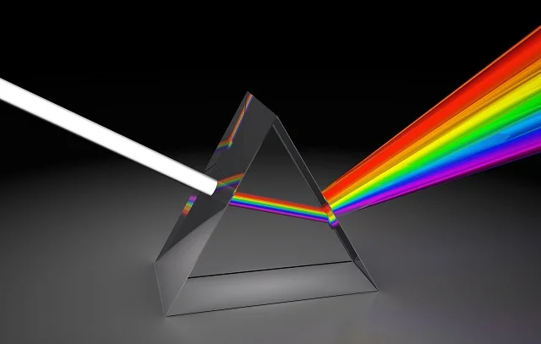
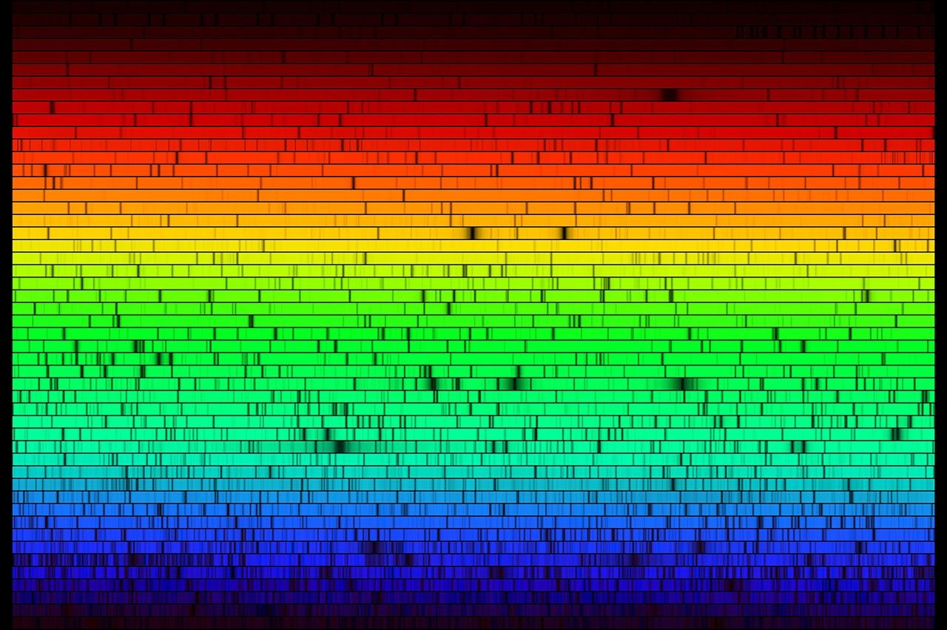
Spectra (Plural of “Spectrum”)
An element you will be looking at today
Light can be separated with a prism - this is called a spectrum
See: Rainbows, where water droplets act as prisms
This happens because different wavelengths refract (bounce or deflect) by different amounts
We don’t always see a full spectrum when we observe things
Sometimes only a few wavelengths (“colors”) are there
Sometimes it's mostly there, but a few are missing
We need to look at how light interacts with matter (specifically atoms)
The Sun!

Slide 7
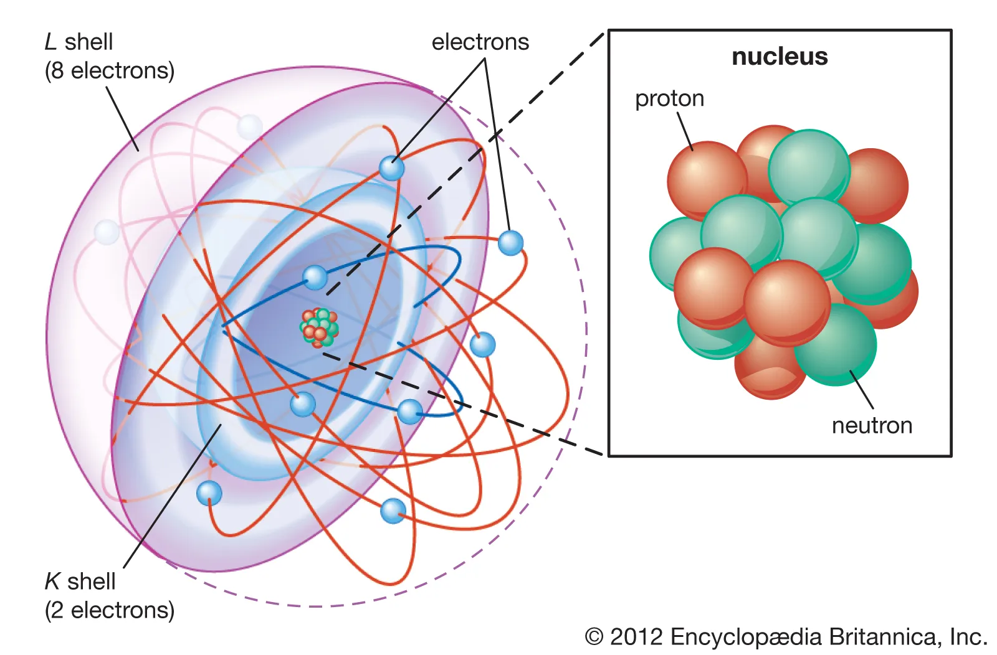
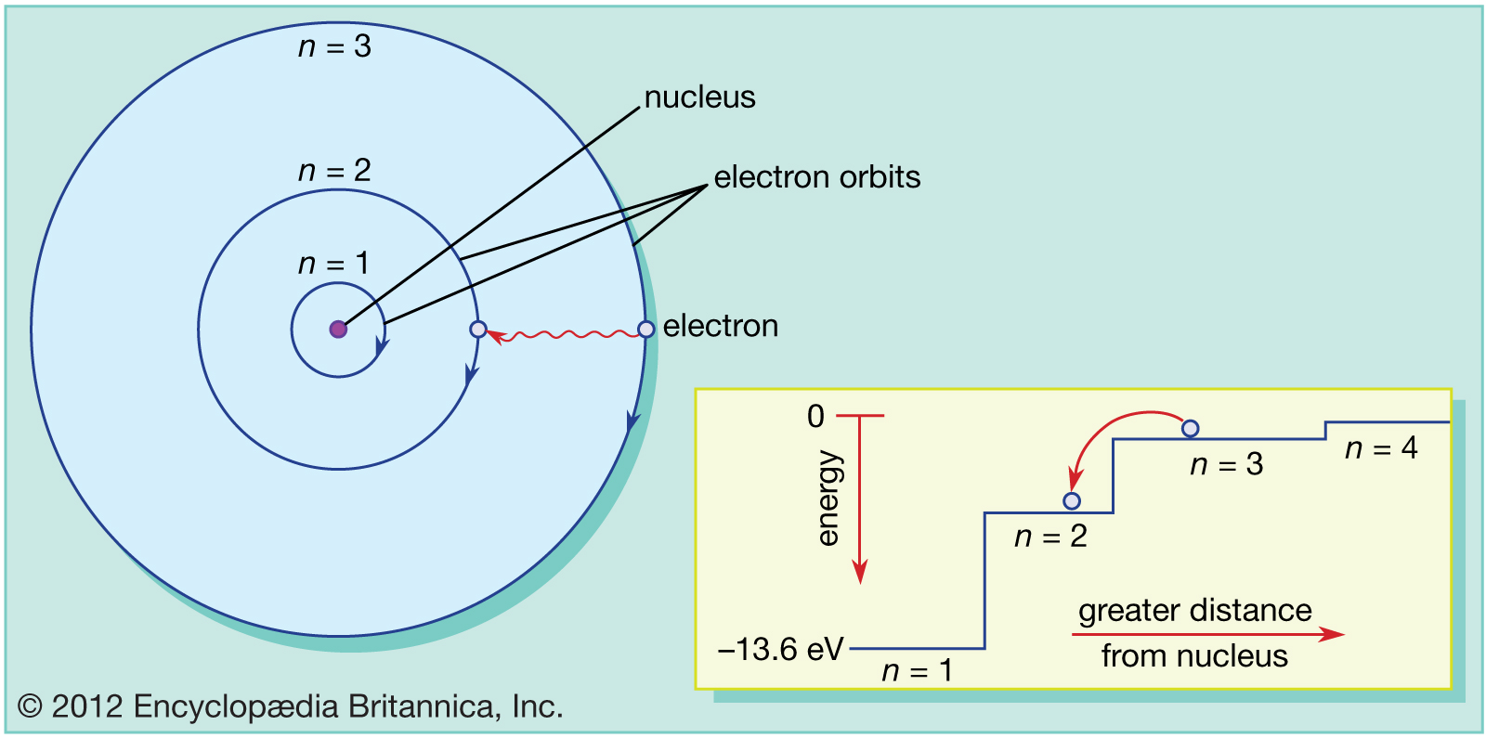
A Brief Aside About Atoms
A nucleus made of protons and neutrons
Not too important for today’s lab
Surrounded by electrons
The electrons can be separated into different “shells” or “orbits”
Each shell represents a single quantized energy level, increasing as you get further from the nucleus
The word “quantized” here is important - it means a specific, discrete (not a continuum) amount
Also where the word “quantum” as in quantum mechanics comes from
Electrons orbiting an atom can only exist at these specific energy levels
Each shell has a maximum number of electrons

Slide 8
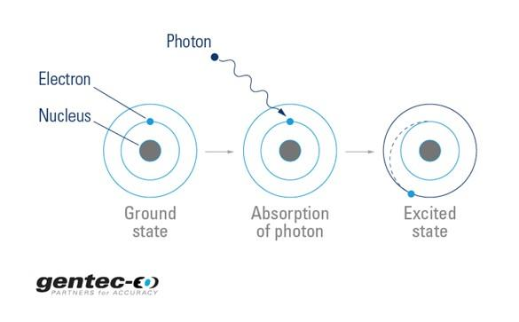
What Happens When Light Hits an Atom?
Absorption!
But light has energy
Energy can never be created or destroyed*
*(Outside nuclear reactions)**
**(But matter is equivalent to energy, see E = mc^2)
So the total energy has to be the same. Where did it go?
One of the electrons took that energy and went up to a higher energy level
Sometimes, the energy is so much that the electron leaves the atom altogether - this process is called “ionization” and the atom is said to be “ionized”

Slide 9
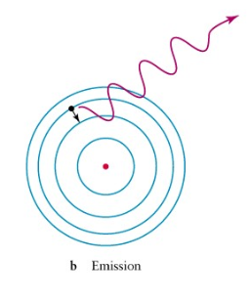
But Does it Stay There?
Electrons don’t like having a lot of energy, they want to be as close to the “ground state” as they can
When an electron drops back down to a lower energy level, the energy it did have still has to go somewhere
So, the atom emits light
v₀ (pronounced “v-nought)” is the speed divided by the wavelength, for us, that is c/𝜆

Slide 10
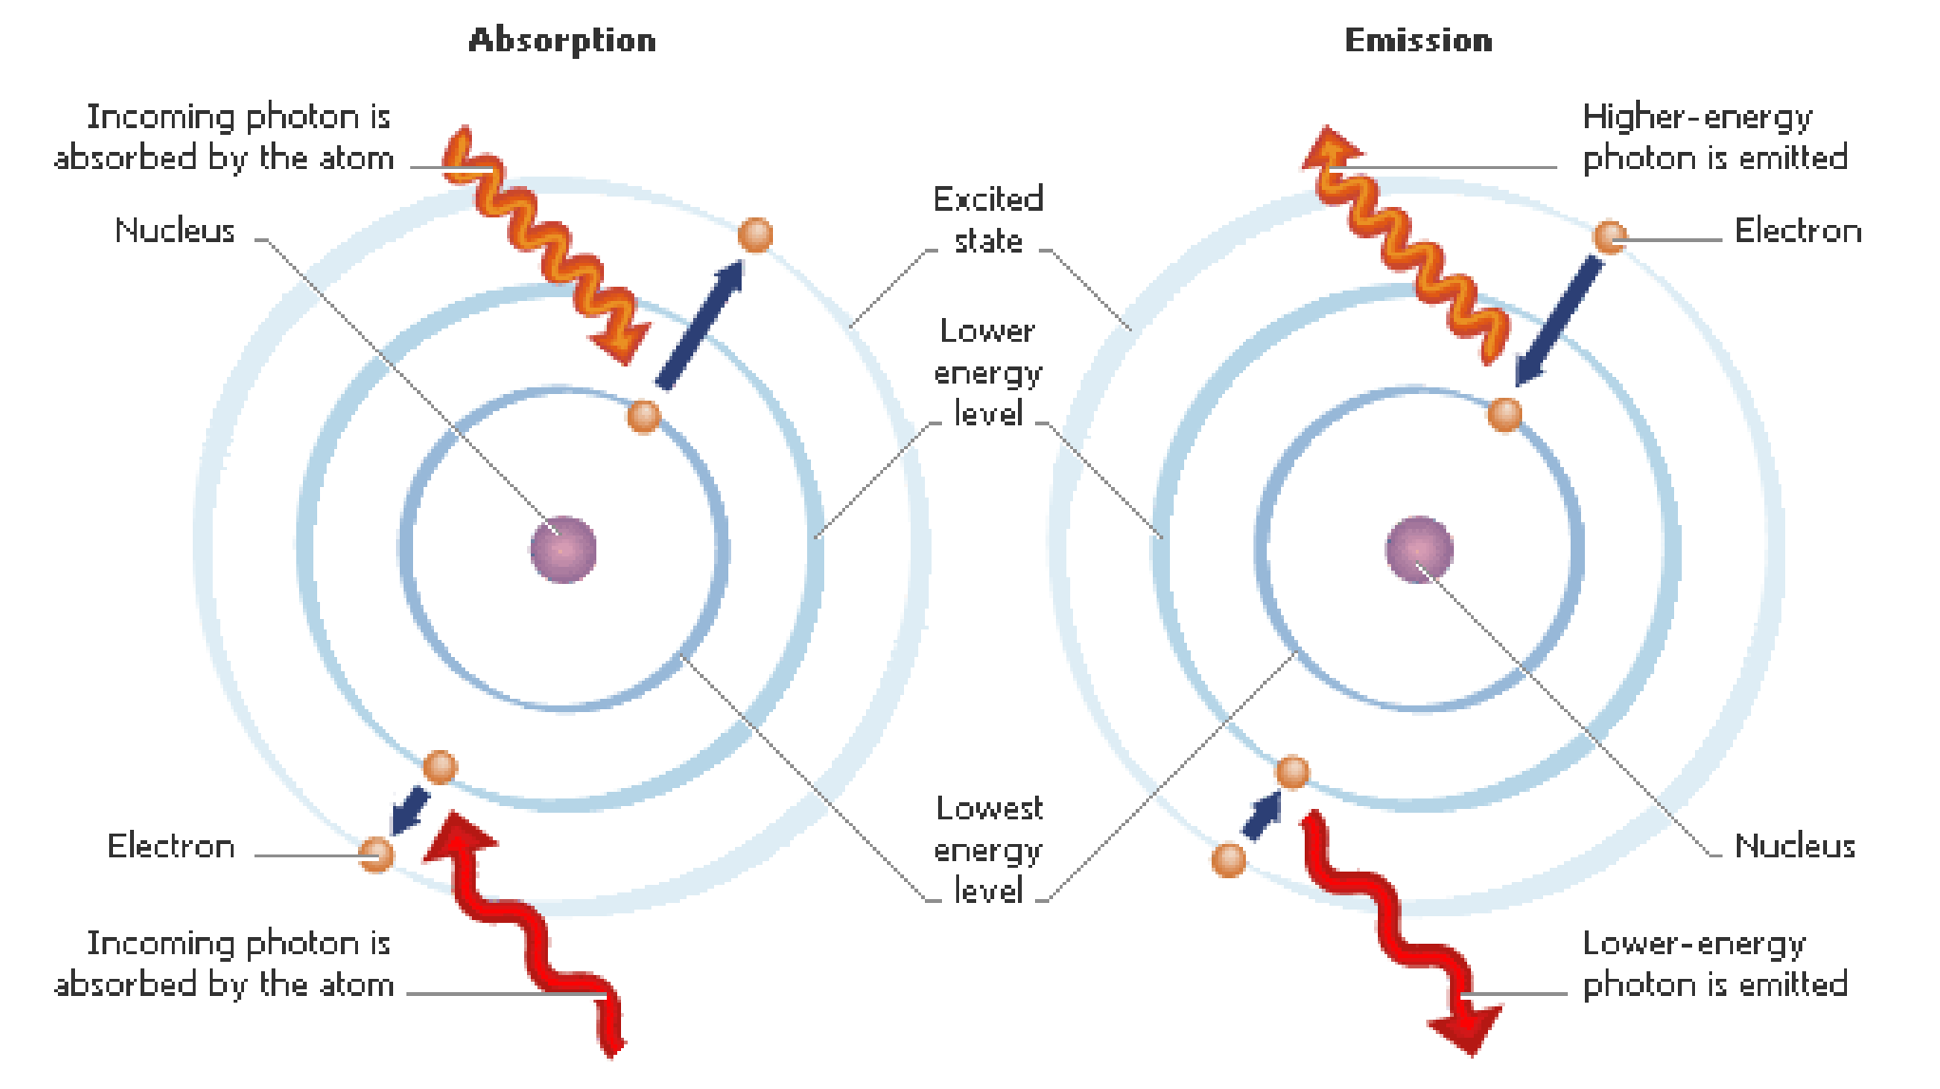
What Does This Mean For Us?
The specific quantized amount of energy absorbed or emitted depends on the atomic structure of the atom - so different elements absorb and emit different specific wavelengths
The more levels up or down the electron goes - the bigger the energy change
So, by looking at what wavelengths (colors) of light are emitted or absorbed we can determine what element something is made out of

Slide 11
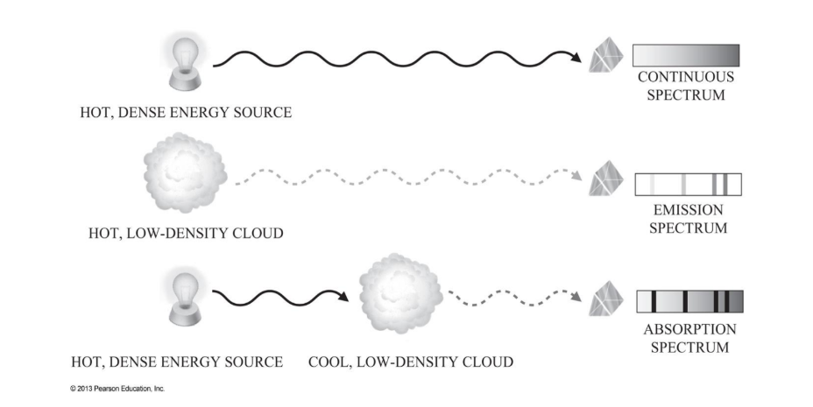
What Does This Mean For Us?

Slide 12
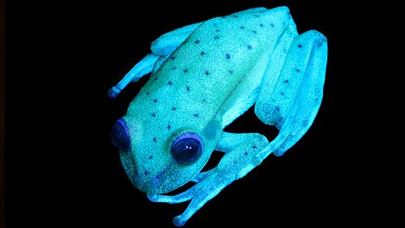
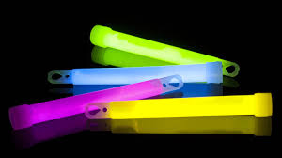

Real-World Examples (Outside Astronomy)
Phosphorescence and Fluorescence are two processes where the absorbed and emitted wavelengths are different
Because of weird quantum mechanics stuff
Phosphorescence
Slow (minutes or hours)
Used on glow in the dark stuff - toys, watch faces, etc.
Fluorescence
Fast (nanoseconds)
Used for lighting, forensics, road signs, industrial QC, and medicine
Some animals even glow
Regular Spectroscopy
Used for finding toxins in food or blood samples, determining the amount of dissolved oxygen in water, and more
Similar Techniques (other types of waves i.e. sound)
Useful in linguistics, geology, music, structural engineering, etc.

Slide 13
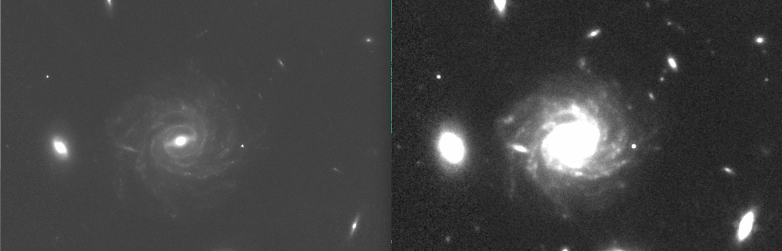
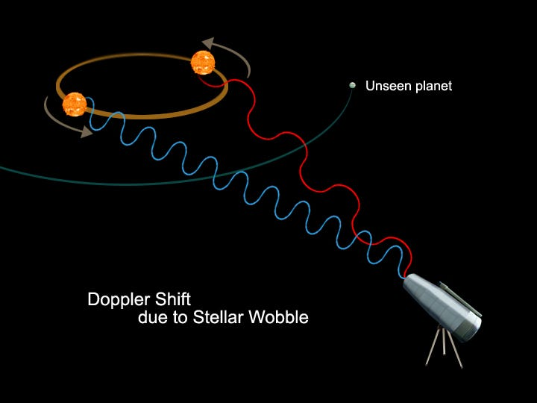
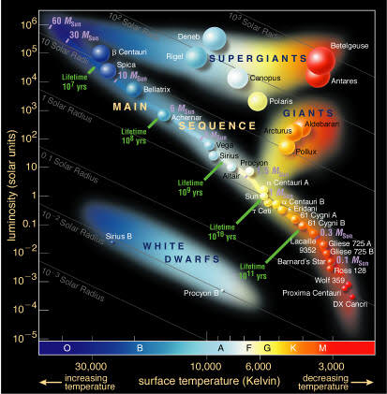
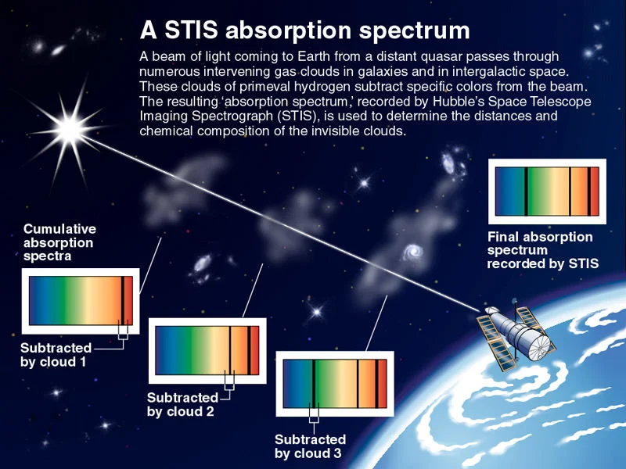
Real World Examples (In Astronomy)
Exoplanets (radial velocity and atmospheric spectroscopy) (learn about in AST 111)
Star temperatures (and therefore mass and age - H-R Diagram) (learn about today and later this semester)
Composition of gas clouds
From the above two: Galaxy age and evolution (my research)
Galaxy movement (later this semester)

Slide 14
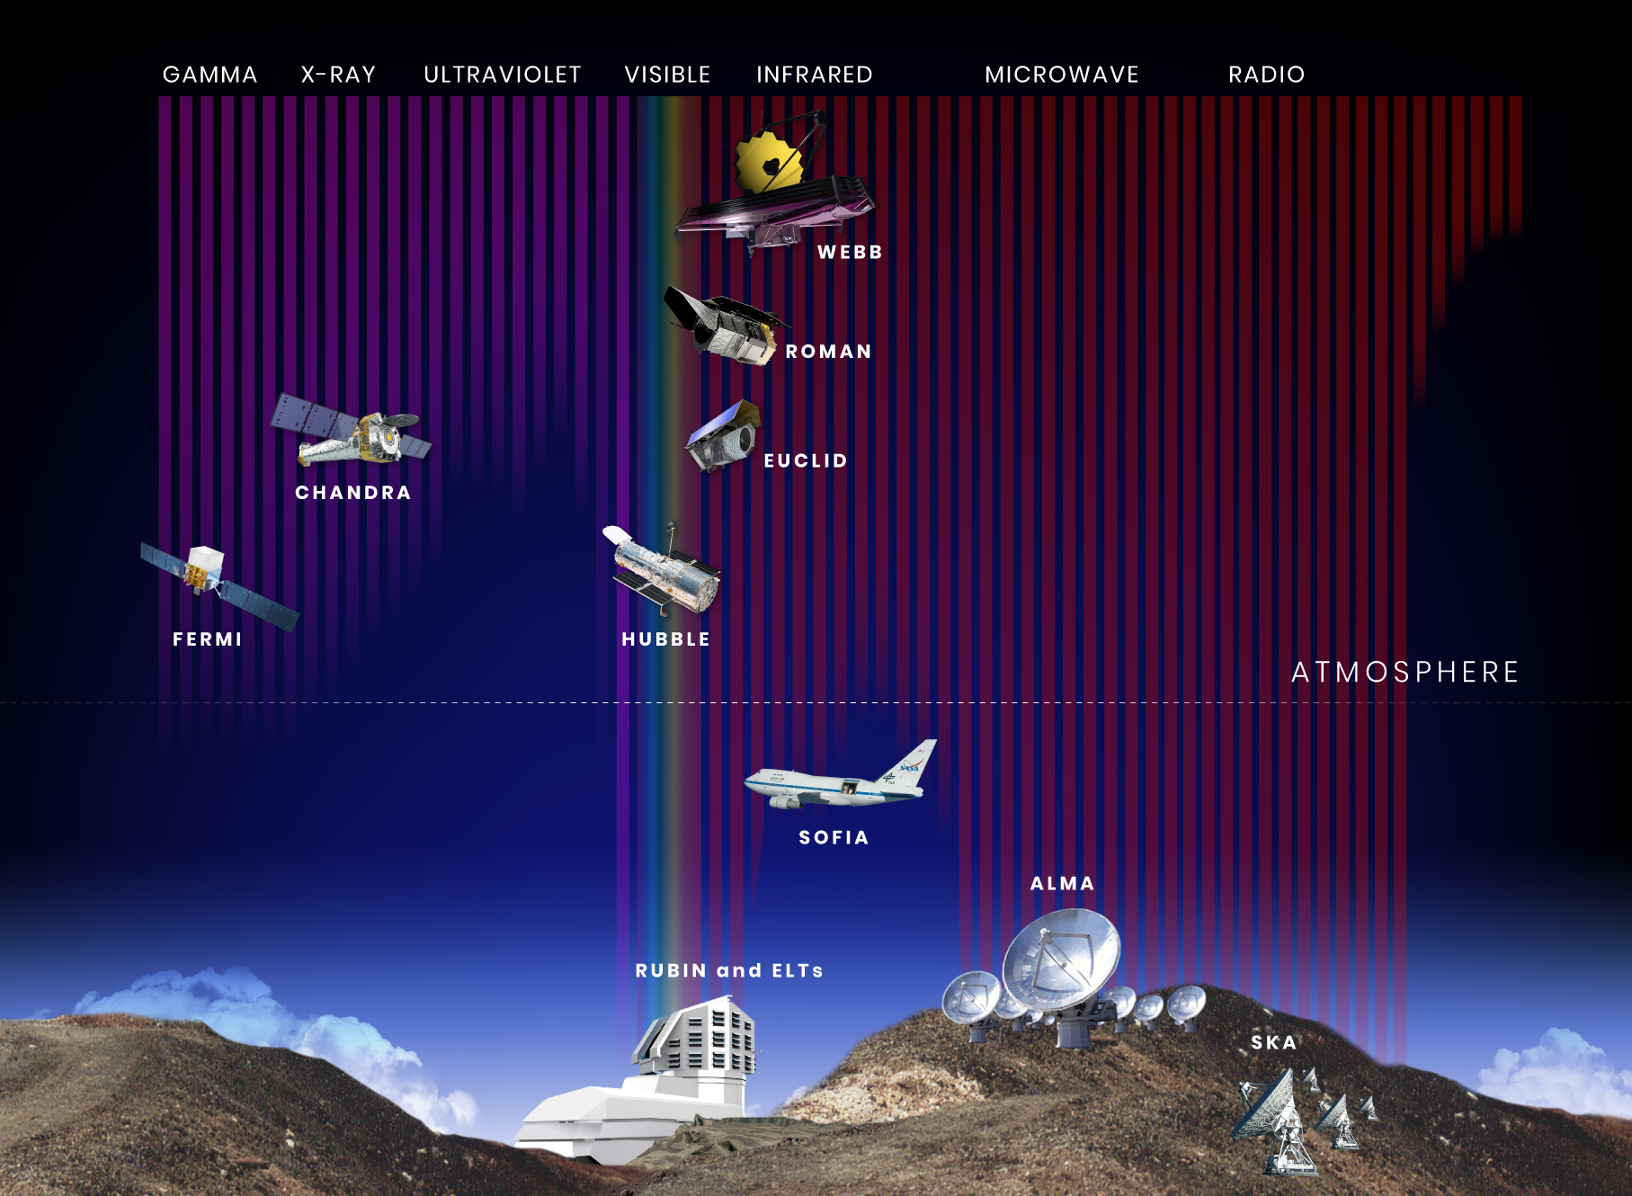

Slide 15
Today
You will be using the spectroscopes to identify 6 elements
If you can’t see anything through them, let me know - it likely just needs to be recalibrated
You will also be using them to look at a fluorescent light (the ceiling lights) and an incandescent light (in the corner)
We don’t have enough stations for everyone at once, so take turns
No need to go in order

Slide 16
Today
Question 9 is one that most people struggle with every semester
Ask for help if you need it
Question 12 doesn’t actually have much work to show since you can just plug it into a calculator…
But make sure to include UNITS
Questions 18 through 24 are extra credit
Worth quite a bit
Remember to do the quiz - due at the same time as the lab
Next week’s lab is Parallax

Slide 17
Scattering
Light can be deflected off an atom and be scattered into the environment
Sometimes this involves splitting up the light into a bunch of different wavelengths, and sometimes it involves reflecting all the light at a specific angle
This is not important to your lab today, but it is why the sky is blue, and why you can use mirrors
It’s also why stealth aircraft often have weird shapes

